Slide 1

Fundamentals of Human-Centered Design
Day 3
Peter Gorman | peter.gorman@opm.gov
Mina Jafarpoor | mina.jafarpoor@opm.gov
Judy Conley | judy.conley@navy.mil
Nick Jones | nicholas.j.jones1@navy.mil
Notes:
NJ

Slide 2

Regroup:
Reconnect + Review
Notes:
NJ

Slide 3
Welcome to Day 3!
How’s everyone doing?
Reconnect + Review
Any thoughts since yesterday?
Notes:
NJ

Slide 4
Day 3 Agenda
Reconnect + Review
Regroup: Reconnect + Review
PROTOTYPE: Studio Work
TEST: Evaluating Prototypes
Break
TEST: Constructive Critique
Lunch 12:00-1:00
TEST: Group Presentations
Reflect: Implications + Evaluation
Wrap up 3:00?
Notes:
PG

Slide 5

PROTOTYPE:
Studio Work
Notes:
PG

Slide 6
Prototype: A Definition
A first simple model, draft, or version of a design or an idea that tests a concept or process in the real world.
Prototype:
A Definition
Studio Work
Notes:
PG
Prototyping is a series of small experiments that helps us to better understand what we’re trying to build, the context or environments within which our product, service, or process will live, and to test our underlying/hidden assumptions.
can take many forms; it might be a sketch, a model made of cardboard, or a role-playing simulation of a service,
But must be tangible: Allows you to observe someone interact with, or ask for direct feedback about.

Slide 7
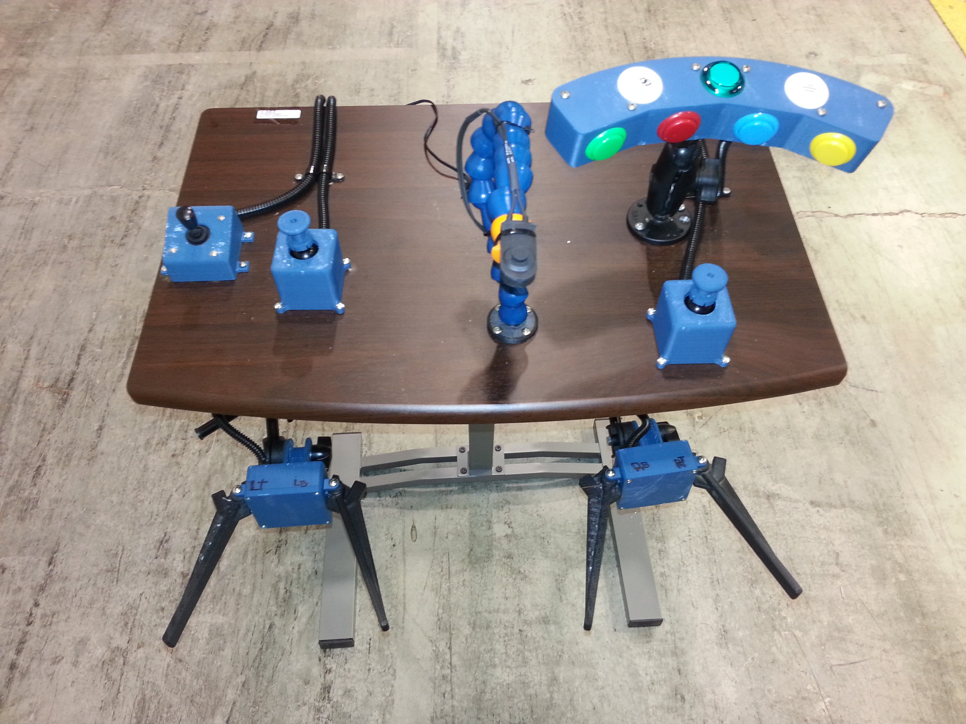
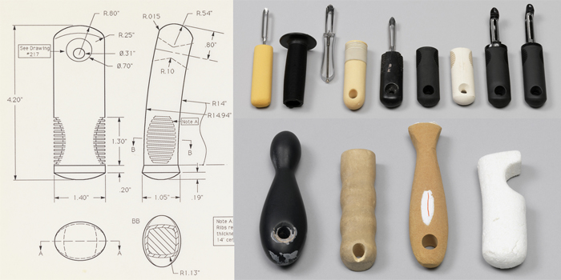
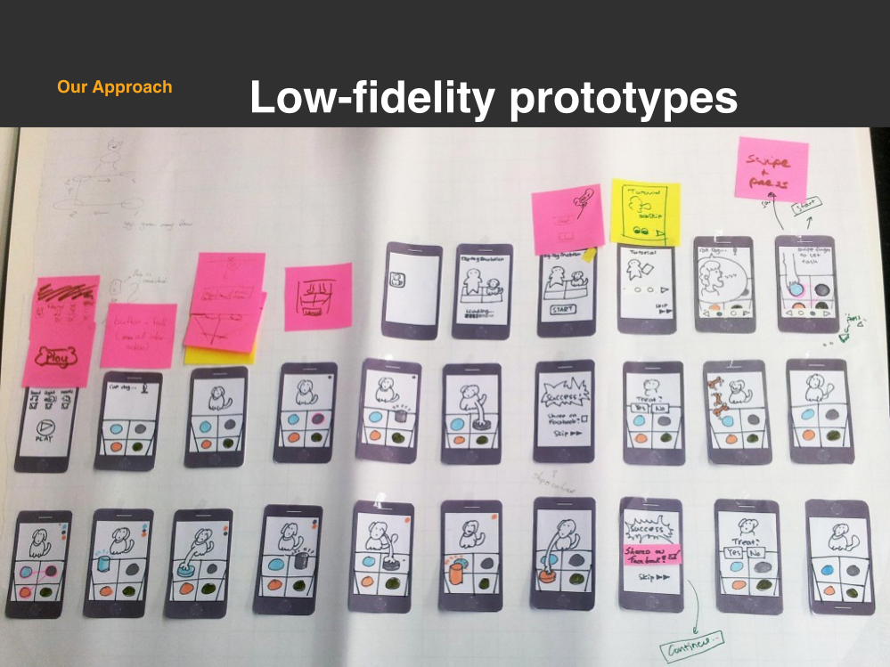
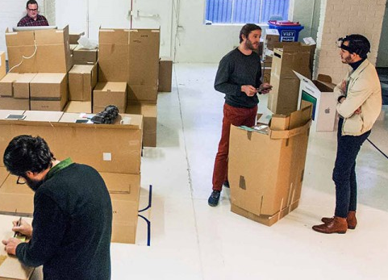
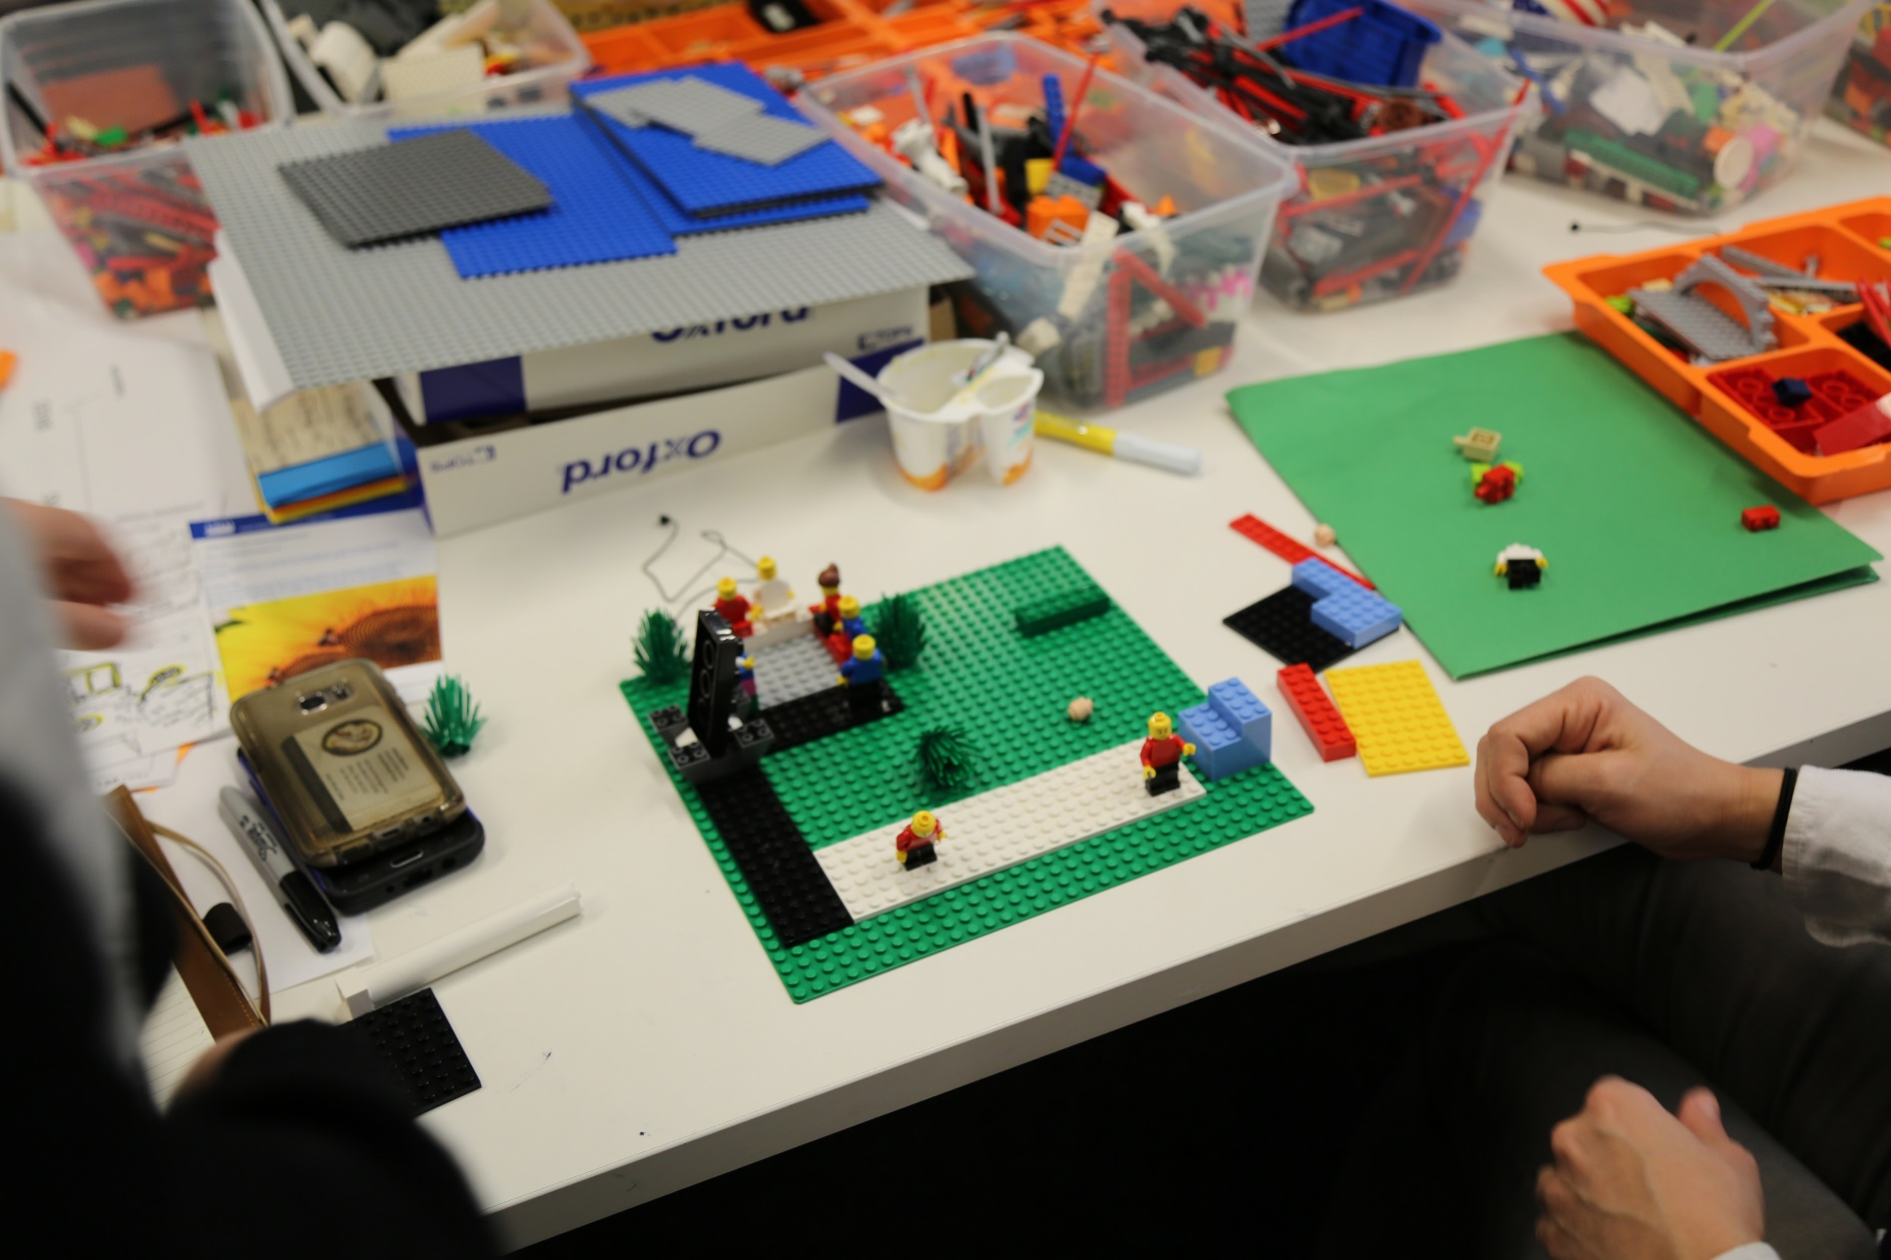
Time to build your own!
Studio Work
Notes:
PG

Slide 8
Studio Work
Prototyping Process
Decide What to Prototype Discuss which components of your design concept are particularly critical to its success and value. Determine which of these elements you need to learn more about through real-world prototyping and testing.
Develop Your Prototype Create a prototype that models one or multiple aspects of your design concept. Use the materials provided or seek out your own. Get creative and be resourceful.
Prepare to Test Prototype Guide someone else (not in your group) through an interaction with your prototype. Observe what’s working and what’s not. Consider how to iterate and refine.
Notes:
PG

Slide 9
TEST:
Evaluating Prototypes
Notes:
MJ

Slide 10
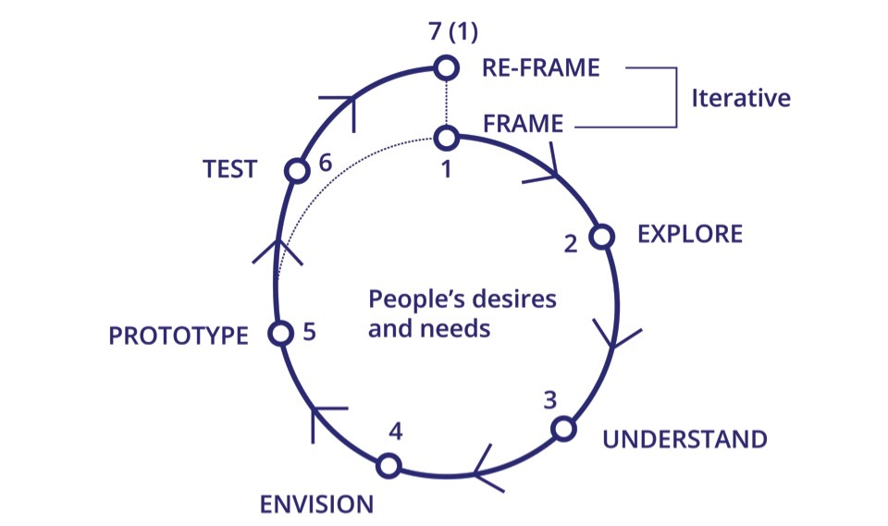
HCD Process Check-In
Evaluating Prototypes
Notes:
MJ

Slide 11
Evaluating Prototypes
Testing Process
Develop a Testing Plan Create a prototype someone else can interact with. Plan what you want them to try, how to explain the test to them, and any prompts you’ll have for them along the way.
Try it Out Yourselves Run through your test with your teammates and make any adjustments needed. Have someone in your group facilitate the test just as they would for someone else.
Invite Someone to Test Invite someone from another group to try your prototype. Set up and run the test it without biasing them. Ask them to think out loud as they go. Watch their interaction closely.
Notes:
MJ

Slide 12
Break
15 min.
Notes:
MJ

Slide 13
TEST:
Constructive Critique
Notes:
JC

Slide 14
Design Critique: A Definition
Constructive Critique
A design critique is a way to discuss and evaluate a set of existing ideas and ways of doing in order to identify what to change (or not) in the future. Design critiques should be constructive and productive.
Notes:
JC

Slide 15
Quality of Critique
Constructive Critique
con·struc·tive adjective
of or relating to construction or creation
promoting improvement or development
Notes:
JC

Slide 16
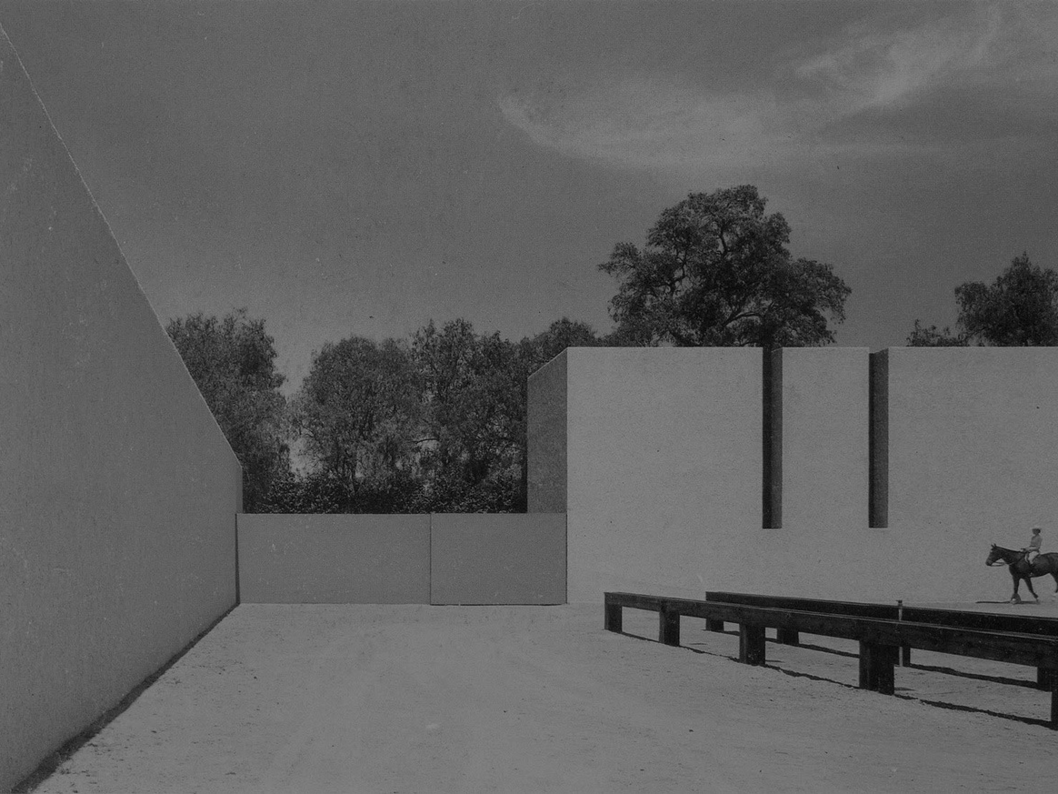
Through [critique] we are able to change future possibilities by how we (re-) interpret the past, and therefore re-think that which we have taken for granted as fixed and immutable.
“
–
Clive Dilnot
Professor of Design Studies
Constructive Critique
Notes:
JC

Slide 17
Tell Us About…
Constructive Critique
Your experience with critique
Notes:
JC

Slide 18
Tell Us About…
Constructive Critique
How you got here today
Notes:
JC

Slide 19
Many Hats of Feedback
Constructive Critique
Write down how you made your way here this morning, and why you chose your approach to getting here.
Find a partner and explain it to them.
You can describe a process or mode of transportation. Keep it brief but descriptive. Make sure you provide your rationale.
Take turns sharing your travel descriptions and providing critique wearing one of the various “hats of feedback” provided.
Notes:
JC
5 mins writing travel descriptions
3 mins describing travel, 2 minutes providing critique
3 mins describing travel, 2 minutes providing critique

Slide 20
Types of Feedback
Constructive Critique
Positive, Negative, Neutral (Often absolutes)
Additive
Reductive
Contextual or Systemic
Alternative Frame
Facilitating Dialogue
Action and Making
What else?
Notes:
JC

Slide 21
Modes of Feedback
Constructive Critique
Impromptu Exchange
Facilitated Presentation (Numerous mediums possible - slides, script, performance, etc.)
Public Forum
Co-design Working Session
Participatory Design
Retrospectives
What else?
Notes:
JC

Slide 22
Shifting Practice
Constructive Critique
FROM
Person
Absolutes
Tearing down
Anonymous
Asynchronous
Clinical, prudent & set in stone
TO
Subject
Nuance and depth
Contributing to
Identifiable
Coordinated/simultaneous
Optimistic, provocative & always in beta
Notes:
JC

Slide 23
Shifting Practice
Constructive Critique
FROM
Features
One directional (one-and-done)
Hierarchical
About the physical
Via technology
TO
Process and experience
Collaborative dialogue
Giving and receiving
About the intangible
Via personal interaction
Notes:
JC

Slide 24
Tell Us About…
Constructive Critique
What you brought with you here today
Notes:
JC

Slide 25
More Fruitful Feedback
Constructive Critique
Take stock of what you brought with you to class today, and why you chose these items to bring with you.
Find a partner and explain it to them.
Talk about your accessories, electronics, clothing, etc... Keep it brief but descriptive. Be sure to provide your rationale.
Take turns sharing your descriptions and offering constructive critique to each other.
Notes:
JC
3 mins describing items, 2 minutes providing critique
3 mins describing items, 2 minutes providing critique

Slide 26
Critique in Context
Constructive Critique
Project Timeline
Beginning
Middle
End
Notes:
JC

Slide 27
Critique in Context
Constructive Critique
Project Timeline
CDC
Public Forum/Symposium
Prior to scoping any work: Feedback on discipline and methodology to be potentially used during a project.
Notes:
JC

Slide 28
Critique in Context
Constructive Critique
Project Timeline
RAIO
Participatory Design Workshops
Early problem-framing workshops and visioning workshop post-research
Notes:
JC

Slide 29
Critique in Context
Constructive Critique
Project Timeline
USA Jobs
Co-design Sessions and Retrospectives
During and after research and development cycles
Notes:
JC

Slide 30
Critique in Context
Constructive Critique
Project Timeline
Internal Lab critiques:
The Lab at OPM
Regular Internal Critiques
Monthly/periodic design critiques, retrospectives, and reviews
Notes:
JC

Slide 31
Critique in Context
Constructive Critique
Critique Process
1
2
3
4
5
Assessing
Preparation
Presentation
Receiving Feedback
Using Feedback
Notes:
JC

Slide 32
Critique Session Roles
Constructive Critique
PRESENTER(S)
Frame context of the material, provide a narrative about the work and ask for feedback.
NOTE TAKER(S)
Keep thorough notes on each contributor’s feedback and share notes
MODERATOR
Maintain guidelines through facilitation of dialogue and diversify contribution
FEEDBACK PROVIDERS
Ask clarifying questions, and provide clear thoughtful and concise feedback
Notes:
JC

Slide 33
Critique Session Rules
Constructive Critique
Listen closely
Pause and reflect before reacting
Ask for clarity
Use your words
Provide feedback on what it is, not what it is not
Avoid absolutes
Center on the self/selves
Share the floor
Notes:
JC

Slide 34
Lunch
Notes:
JC

Slide 35
TEST:
Design Presentations
Notes:
BW

Slide 36
Reflect:
Implications + Evaluation
Notes:
PG

Slide 37
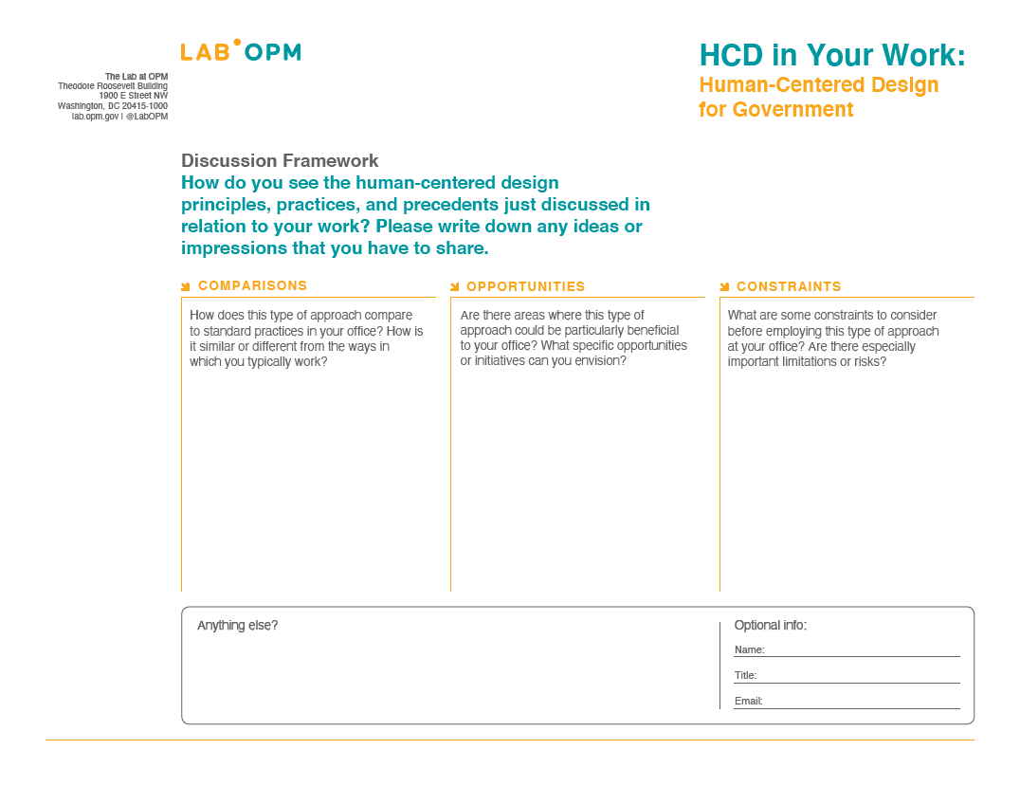
HCD @ NAVAIR
Implications + Evaluation
Notes:
PG

Slide 38
Closing Thoughts
Implications + Evaluation
Following Up
Slide decks
Framework posters
Reading list
Email listserv
Other resources?
Notes:
PG

Slide 39
Closing Thoughts
Implications + Evaluation
Following Up
Slide decks
Framework posters
Reading list
Email listserv
Other resources?
Partnership Possibilities with the Lab at OPM!
Notes:
PG

Slide 40
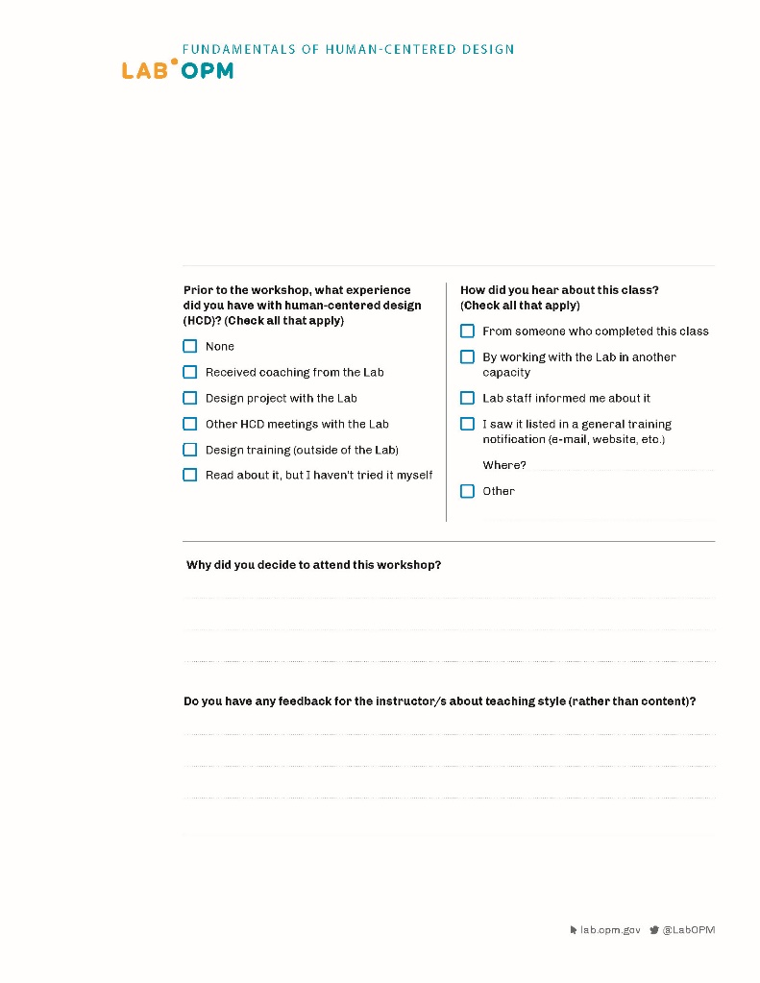
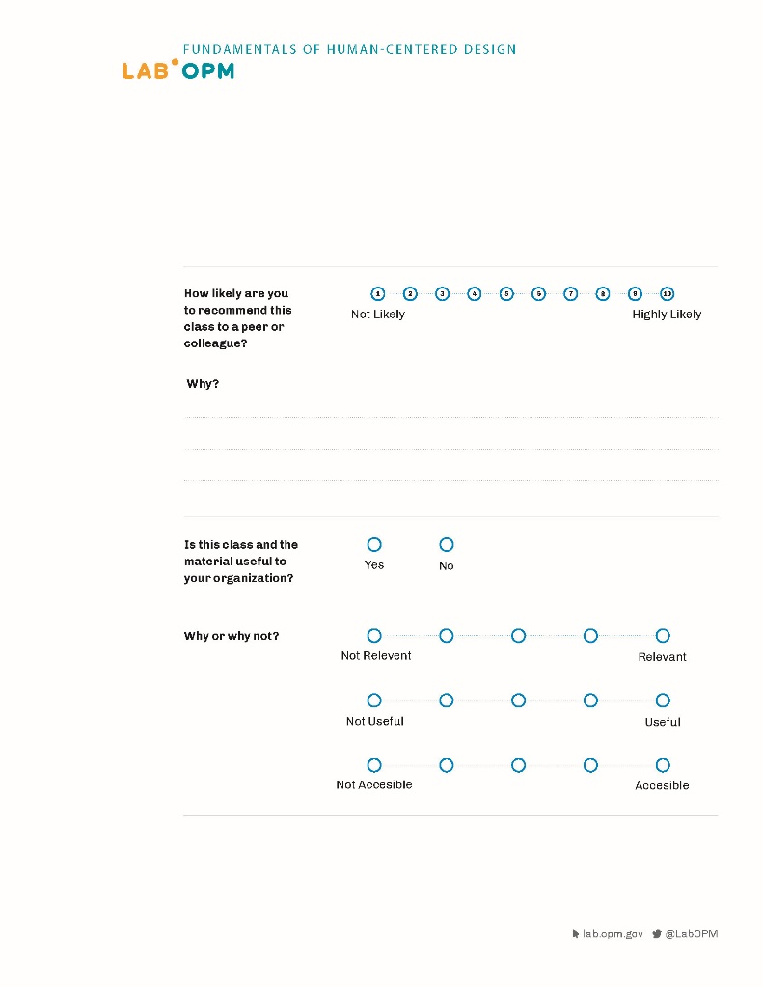
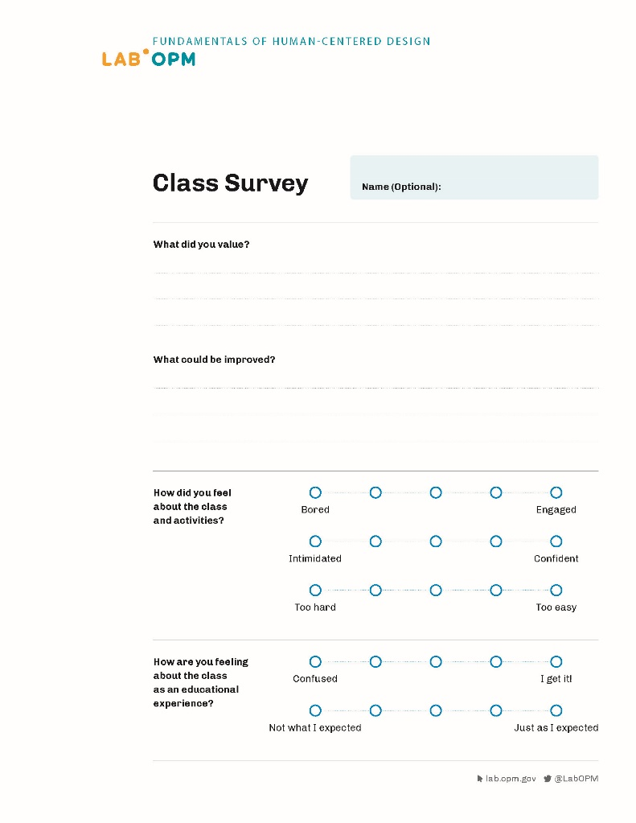
Course Evaluation
Implications + Evaluation
Notes:
PG

Slide 41
Thank You
Notes:
PG

